Slide 1
Cloud Computing Fundamentals
UNIT- 5
1
IoT Unit-5

Slide 2
IaaS
Infrastructure-as-a-Service (IaaS) is a cloud computing model that provides virtualized computing resources over the internet. With IaaS, users can access and manage fundamental IT infrastructure components such as virtual machines (VMs), storage, and networks.
In the IaaS model, the service provider maintains the underlying physical infrastructure, including servers, storage devices, and networking equipment, while users have control over the virtualized resources and the operating systems and applications running on them.

Slide 3
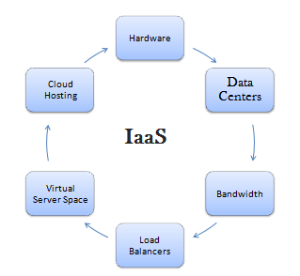

Slide 4
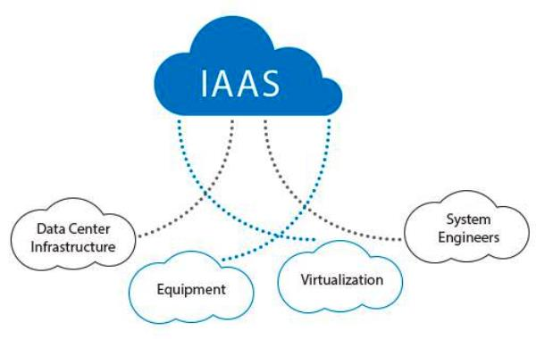

Slide 5
Here are the key components and features of IaaS in cloud computing:
Virtual Machines (VMs): IaaS allows users to create, configure, and manage virtual machines. These VMs act as emulated computers running on the service provider's physical infrastructure. Users can install and run their preferred operating systems and applications on these VMs.
Storage: IaaS provides scalable and flexible storage options. Users can store and retrieve data using various types of storage, such as block storage, object storage, or file storage. These storage resources can be easily expanded or contracted based on user requirements.
Networking: IaaS offers networking capabilities that allow users to create and manage virtual networks, subnets, firewalls, load balancers, and other network components. Users can establish connectivity between virtual machines and define network security policies.

Slide 6
Scalability: IaaS allows users to scale their infrastructure up or down based on demand. They can easily add or remove virtual machines, adjust storage capacity, or modify network configurations to meet their changing needs.
Resource Pooling: IaaS providers typically operate on a multi-tenant architecture, where multiple users share the same physical infrastructure. However, the resources are logically separated, ensuring privacy and security for each user.
Self-Service Provisioning: With IaaS, users have the flexibility to provision and manage their infrastructure resources on-demand. They can allocate and configure VMs, storage, and networking resources without depending on the service provider.
Billing and Metering: IaaS follows a pay-per-use model, where users are billed based on their resource consumption. The service provider tracks the usage of virtual machines, storage, and network resources, allowing users to optimize their costs and allocate resources efficiently.

Slide 7
PaaS
Platform-as-a-Service (PaaS) is a cloud computing model that provides a platform for developing, deploying, and managing applications over the internet. With PaaS, users can focus on application development and deployment without worrying about the underlying infrastructure and related tasks.
In the PaaS model, the service provider delivers a complete development environment, including the hardware infrastructure, operating system, runtime environment, development tools, and deployment services. Users can leverage these services to build, test, and deploy their applications more efficiently.

Slide 8
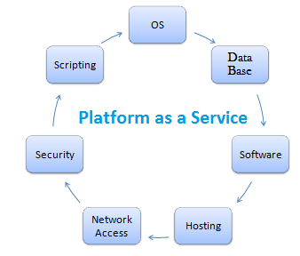

Slide 9
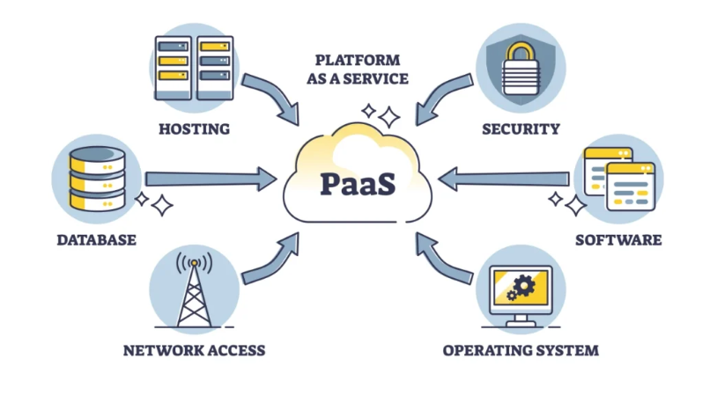

Slide 10
Here are the key components and features of PaaS in cloud computing:
Development Environment: PaaS offers a pre-configured and managed
development environment that includes programming languages, libraries,
frameworks, and development tools. Users can write, debug, and test their
applications directly within the platform.
Deployment Services: PaaS provides deployment services that automate application deployment and scaling. Users can easily deploy their applications to the platform and take advantage of automated scaling capabilities to handle changes in user demand.
Application Lifecycle Management: PaaS facilitates the management of the entire application lifecycle, including development, testing, deployment, and maintenance. It provides tools for version control, collaboration, monitoring, and troubleshooting.

Slide 11
Scalability and Availability: PaaS platforms typically offer built-in
scalability and high availability features. Users can scale their applications
horizontally or vertically based on demand without worrying about infrastructure provisioning or configuration.
Integration Capabilities: PaaS platforms often provide integration services, allowing users to connect their applications with other services or APIs. This enables seamless data exchange and integration with external systems such as databases, messaging queues, or third-party services.
Database and Storage Services: PaaS includes managed database and storage services. Users can utilize these services to store and manage application data without the need for manual database setup or administration.
Collaboration and Teamwork: PaaS platforms often support collaboration features that enable teams to work together on application development and share resources, code repositories, and project management tools.

Slide 12
Cost Optimization: PaaS follows a pay-as-you-go model, where users are billed based on their resource consumption. It allows users to optimize costs by dynamically adjusting resources and scaling based on application requirements.
PaaS is particularly advantageous for developers and businesses looking to streamline the application development process, reduce infrastructure management overhead, and improve time-to-market. It provides a flexible and scalable environment that allows developers to focus on writing code and building applications rather than managing servers and infrastructure.
Some popular examples of PaaS providers include Heroku, Google App Engine, Microsoft Azure App Service, and AWS Elastic Beanstalk.

Slide 13
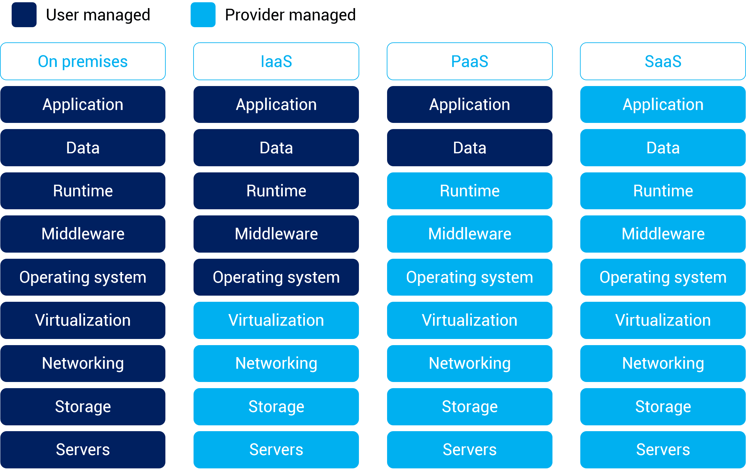

Slide 14
Properties and Characteristics

Slide 15
Multi-Cloud
Multi-cloud is the use of two or more cloud providers together, they might be public, private or a mix of both to achieve the organization’s goals. Basically, it is the use of various types of cloud operators to have more features and increase their organization’s flexibility which also covers the disadvantages of the individual platforms. Companies prefer multi-cloud environments as they can distribute computing resources and minimize the risk of downtime and data loss.

Slide 16
Why Use a Multi Cloud?
Multi cloud strategy empowers organization with flexibility, resilience and performance optimization. It access multi diverse cloud services and provides innovation and mitigating risks. The following are the reasons to use Multi Cloud Strategy:
Flexibility and Redundancy: It offers the flexibility to choose the best services from different cloud providers ensuring redundancy and reducing risk of downtime.
Vendor Lock-in Mitigation: It helps organizations to avoid dependency on single cloud provider. It helps to avoid the mitigating risks associated with vendor lock-in and negotiation leverage.
Optimized Performance: On using multiple cloud providers facilitates in optimizing the workload based on specific requirements such as geographical locations, scalability and cost.

Slide 17
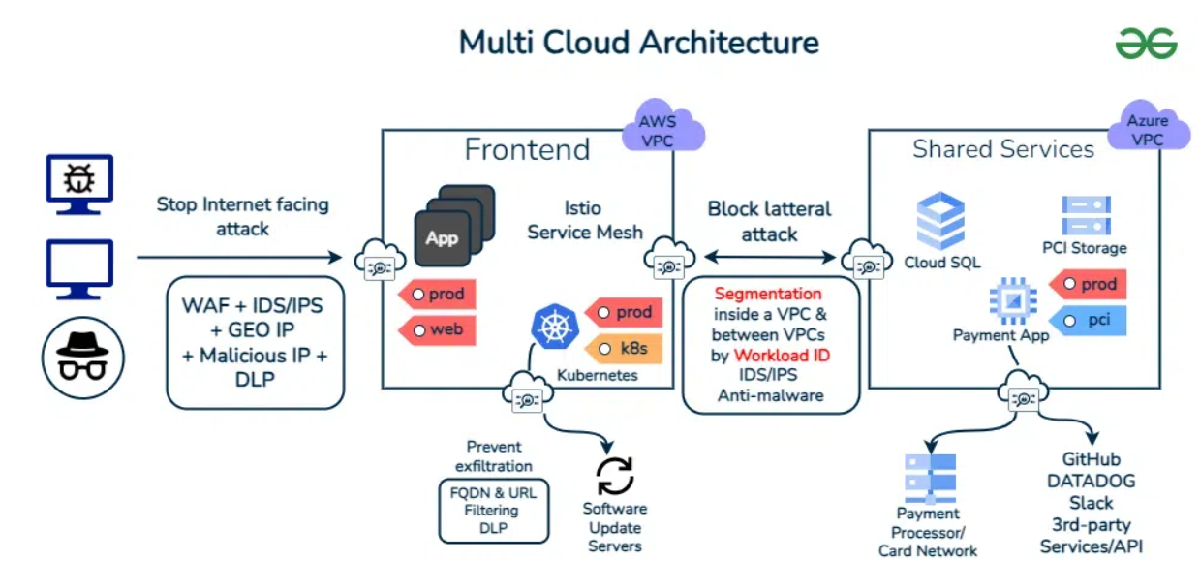

Slide 18
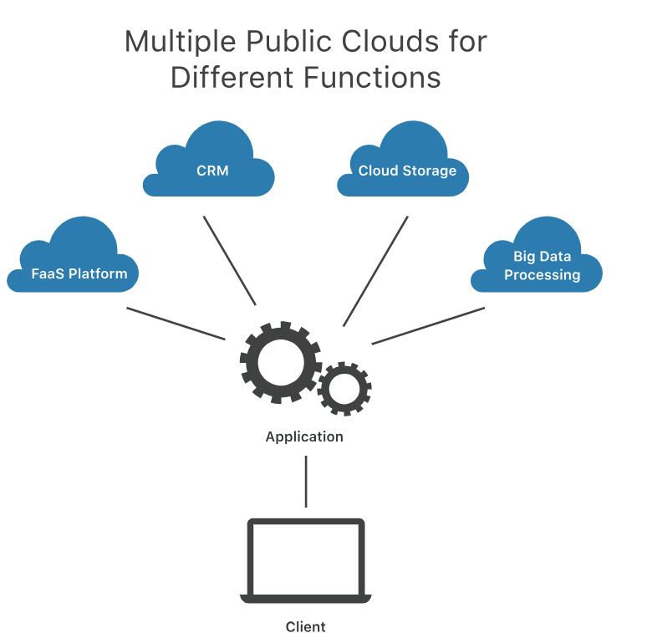

Slide 19
Advantages of Using Multi-Cloud Strategy
Vendor Flexibility: It provides flexibility of using multi cloud providers for organizations to use best services and pricing models from each vendor.
Risk Mitigation: It reduces the risk of data loss, by distributing and maintaining the workload across mutli cloud platforms enhancing resilience and disaster recovery.
Geographic Reach: It facilitates organizations to deploy resources in multi regions across the world. It improves the performance of global users ensuring compliances.

Slide 20
Disadvantages of using Multi-Cloud Strategy
Talent Management: Finding the right people to manage and develop on a multi-cloud infrastructure can be a hassle.
Cost estimation, Optimization and Reporting: Getting a multi cloud provider might sound easy and cheap but estimating the costs and consolidating it is tough.
Security Risks : Handling a multi cloud environment is difficult because they have to manage all individual providers and their respective security protocols which increases complexity in maintaining consistent security standards.

Slide 21
Inter-cloud
Inter-cloud computing (also known as cloud federation or cloud-of-clouds) is a model where multiple cloud environments—possibly from different providers—interact, share resources, and collaborate to deliver services seamlessly. This could be:
Public-to-public (e.g., AWS to Azure)
Public-to-private

Slide 22
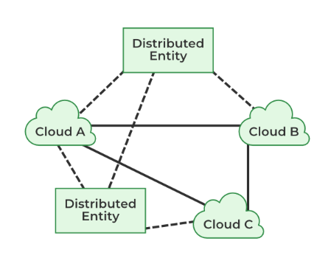

Slide 23
Why Inter-cloud in IoT?
IoT ecosystems involve massive amounts of data generated by heterogeneous devices (sensors, actuators, etc.) often spread across wide geographic areas. A single cloud provider may not always offer:
Low latency
Compliance with local data regulations
Scalability and flexibility
Data locality or edge processing needs

Slide 24
Benefits of Inter-cloud in IoT
Scalability: Use multiple clouds to handle huge, dynamic data loads.
Redundancy and reliability: Improve uptime through failover systems across clouds.
Data sovereignty: Store and process data in specific regions based on laws.
Specialization: Use clouds that specialize in different tasks (e.g., analytics vs. storage).
Cost Optimization: Choose the most economical option dynamically.

Slide 25
Use Cases
Smart Cities: Data from traffic systems, utilities, and public safety systems are processed across multiple clouds.
Healthcare IoT: Sensitive patient data processed on a local private cloud, while anonymized data is sent to a public cloud for analytics.
Industrial IoT (IIoT): Edge devices stream to local clouds; summary or alert data flows into a central or public cloud for dashboarding.

Slide 26
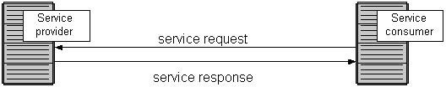
Service Oriented Architecture(SOA)
Definition
Service Oriented Architecture (SOA) is essentially a collection of
services which communicate with each other
Contain a flexible set of design principles used during the phases of systems development and integration
Provide a loosely-integrated suite of services that can be used within
multiple business domains
Approach
Usually implemented by Web Service model

Slide 27

Service Level Agreement (SLA)
Definition
A service-level agreement (SLA) is a contract between a network service provider and a customer that specifies, usually in measurable terms (QoS), what services the network service provider will furnish
Common content in contract
Performance guarantee metrics
Up-time and down-time ratio
System throughput
Response time
Problem management detail
Penalties for non-performance
Documented security capabilities

Slide 28
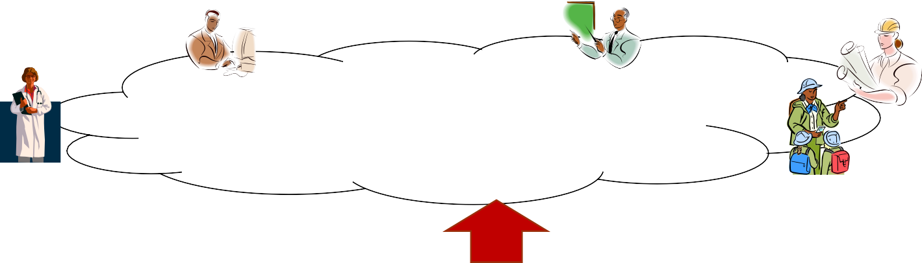



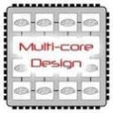
Enabling Technologies
Cloud applications: data-intensive, compute- intensive, storage-intensive
Bandwidth
WS
Services interface
Web-services, SOA,WS standards
VM0
VM1
VMn
Storage Models: S3, BigTable, BlobStore, ...
Virtualization: bare metal, hypervisor. …
Multi-core architectures
64-bit processor
IoT Unit-5

Slide 29
Common Features of Cloud Providers
Development Environment: IDE, SDK, Plugins
Production Environment
Table Store
<key, value>
Simple storage
Drives
Accessible through Web services
Management Console and Monitoring tools
& multi-level security

Slide 30

Windows Azure
Enterprise-level on-demand capacity builder
Fabric of cycles and storage available on-request for a cost
You have to use Azure API to work with the infrastructure offered by Microsoft
Significant features: web role, worker role , blob storage, table and drive-storage

Slide 31
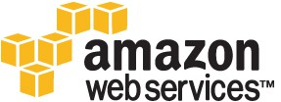
Amazon EC2
Amazon EC2 is one large complex web service.
EC2 provided an API for instantiating computing instances with any of the operating systems supported.
It can facilitate computations through Amazon Machine Images (AMIs) for various other models.
Signature features: S3, Cloud Management Console, MapReduce Cloud, Amazon Machine Image (AMI)
Excellent distribution, load balancing, cloud monitoring tools

Slide 32
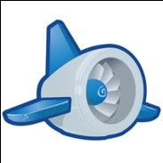
Google App Engine
This is more a web interface for a development environment that offers a one stop facility for design, development and deployment Java and Python-based applications in Java, Go and Python.
Google offers the same reliability, availability and scalability
at par with Google’s own applications
Interface is software programming based
Comprehensive programming platform irrespective of the size (small or large)
Signature features: templates and appspot, excellent monitoring and management console

